Slide 1
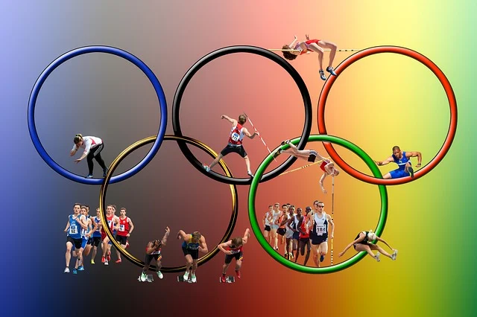
OLYMPIC DATASET ANALYSIS
POOJA SINHA

Slide 2

Introduction
In this analysis, we delve into a dataset encompassing various aspects of Olympic Games, including the years, names, seasons, host cities, and other essential details. While this dataset serves as a foundational source of information, our aim is to uncover insights and trends that shed light on the evolution and dynamics of the Olympics over time.

Slide 3
POWER BI ANALYSIS

Slide 4
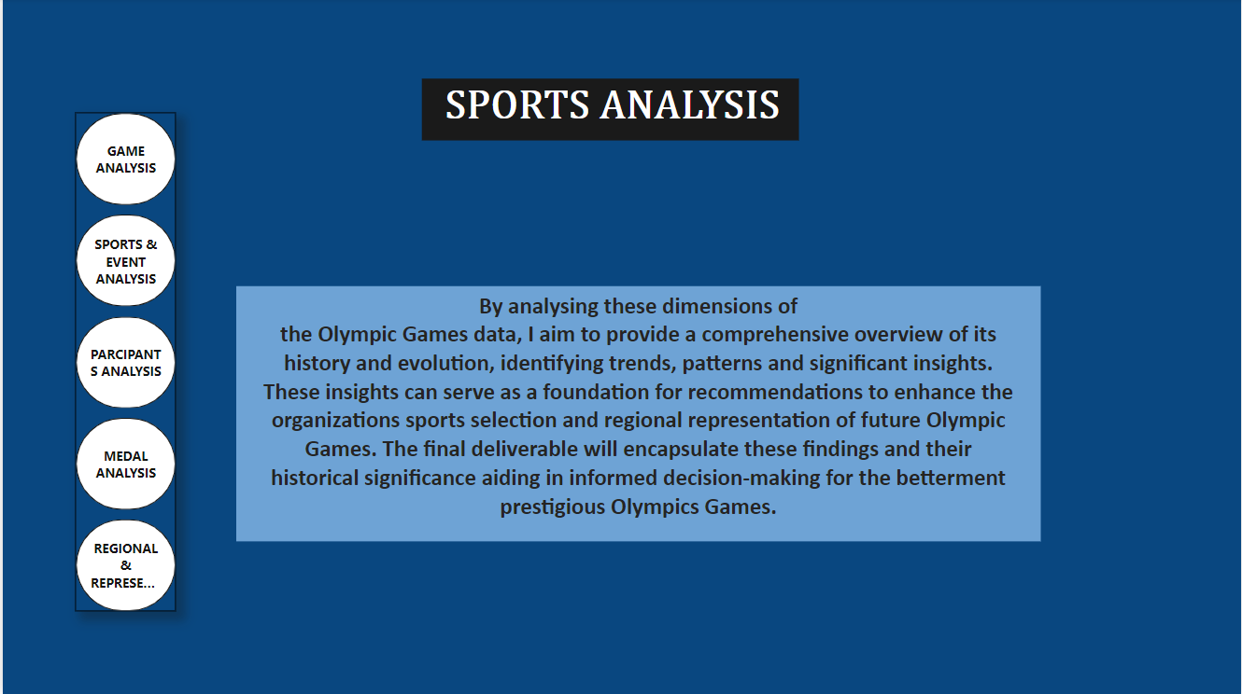

Slide 5
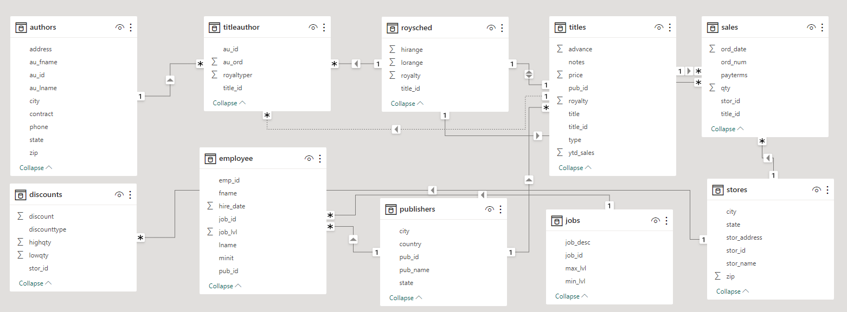
ER DAIGRAM

Slide 6
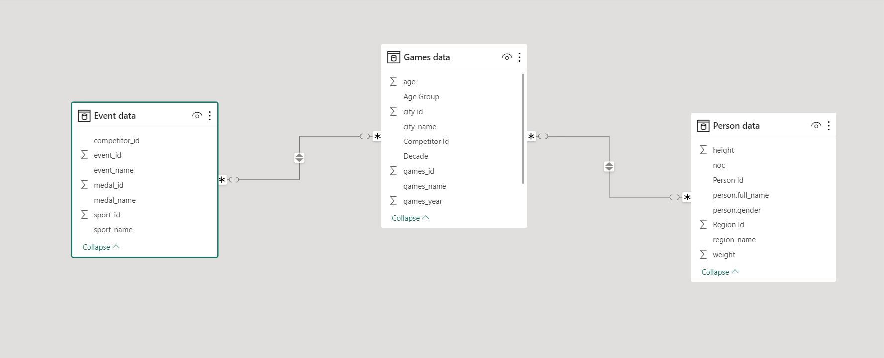

Slide 7
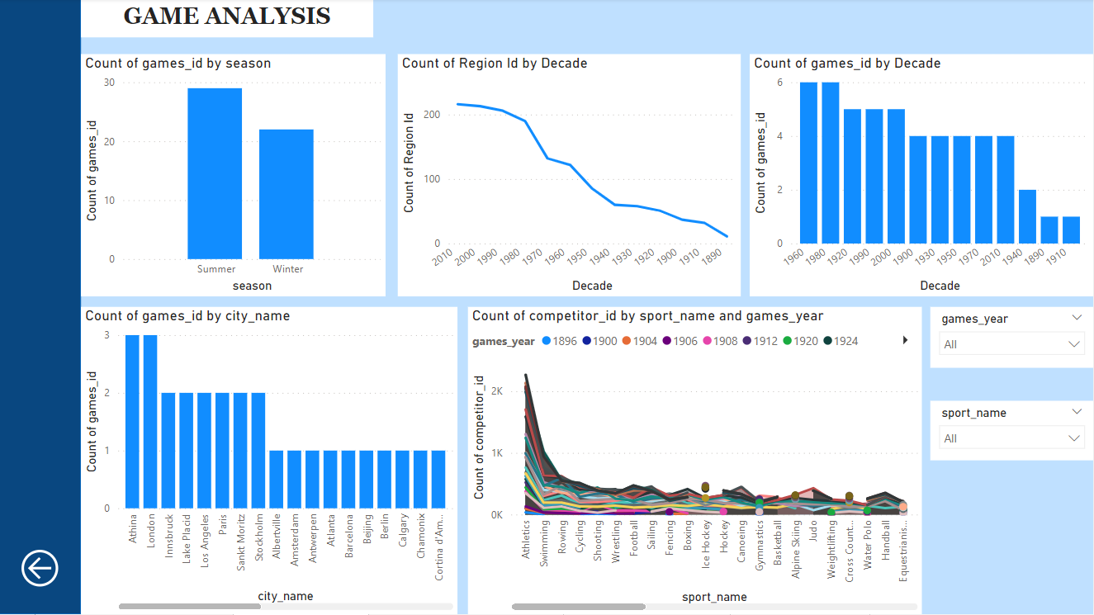

Slide 8
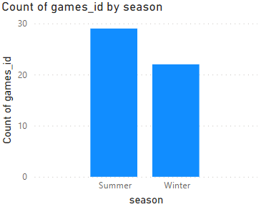
How many Olympic Games have been held in each season (Summer vs. Winter)?
Based on the dataset, the analysis reveals, higher frequency of Summer Olympics in the dataset, emphasizing their more frequent occurrence in comparison to the Winter Olympics.

Slide 9
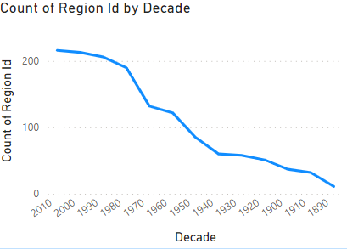
Find trends in number of participating countries in Olympic games Decade wise.
Based on the dataset, the analysis reveals that the highest number of regions have participated in the decade 2010. Hence we can see an increasing trend in the number of participating regions.

Slide 10
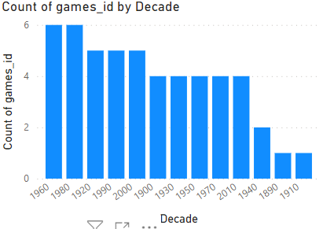
What is the distribution of games across different decades?
Based on the dataset, the analysis reveals that decade 1980 & 1960 have the highest number of Olympic games, wherein decade 1890 & 1910 have the lowest number of Olympic games.

Slide 11
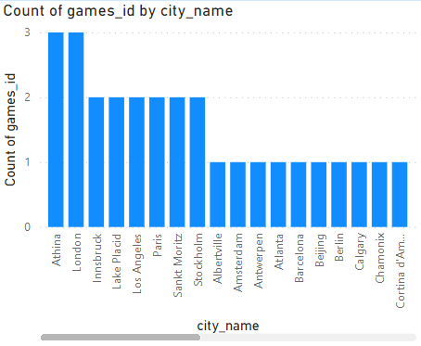
Multi City hosting analysis.
Based on the dataset, the analysis reveals that cities like, Athena and London have hosted the Olympic games for more than 2 times.

Slide 12
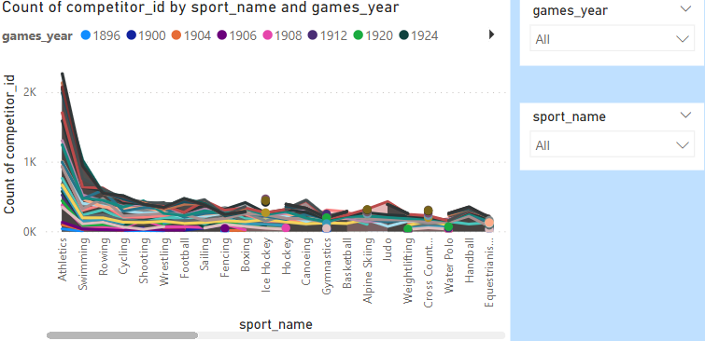
How has the participation in each sport evolved over time?
Based on the dataset, the analysis provide the number of participants in each sports year wise. By using the filter one can see the highest and lowest number of participation in the individual sports.

Slide 13
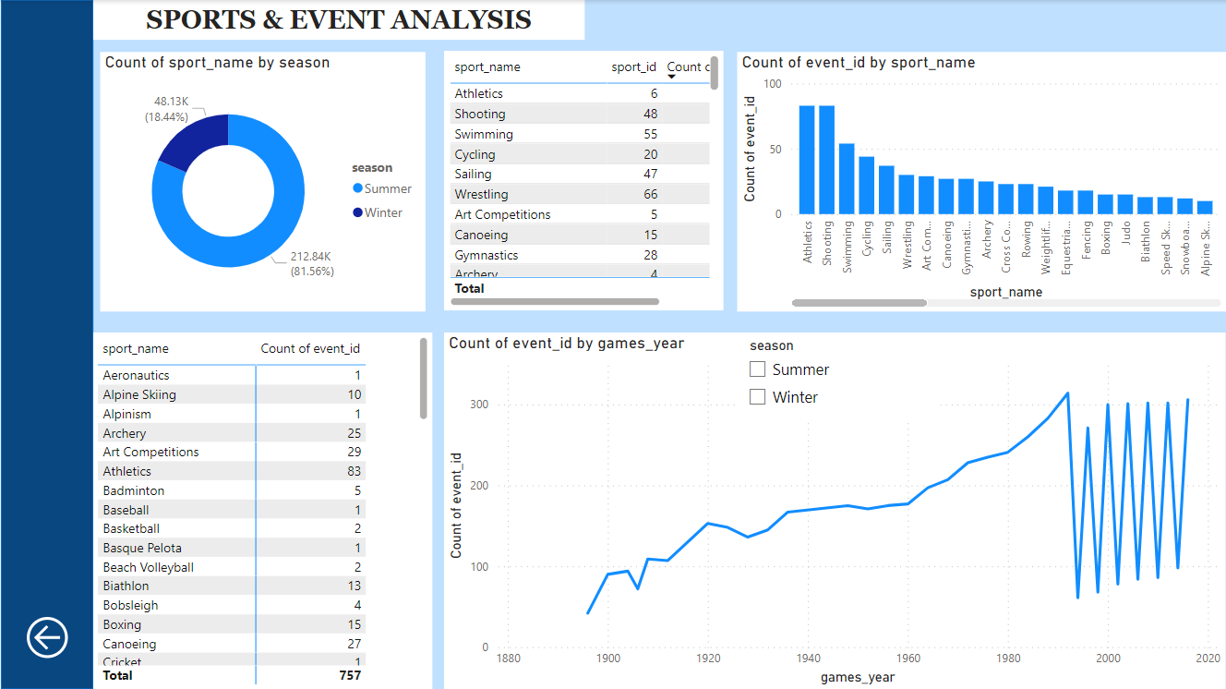

Slide 14
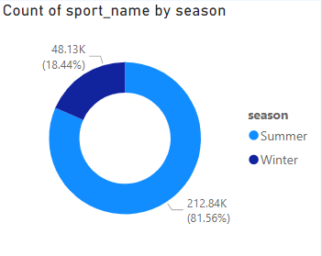
What is the distribution of sports between Summer and Winter Olympics?
Based on the dataset, the analysis reveals, higher frequency of Summer sports in the dataset, emphasizing their more frequent occurrence in comparison to the Winter sports.

Slide 15
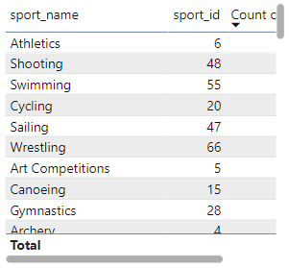
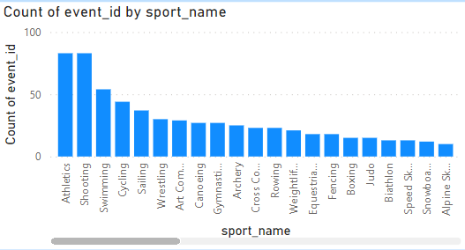
Which sports have the highest number of events in the Olympics?
Bases on the dataset, the analysis reveals that the highest number of events are there in Athletics and Shooting followed by swimming and cycling.

Slide 16
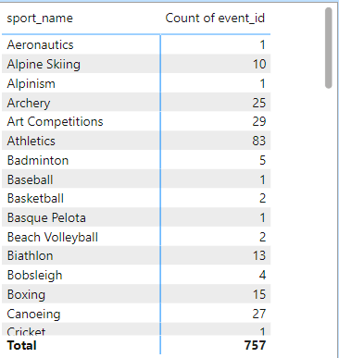
How many events are there in each sport?
Bases on the dataset, the analysis reveals that sports like Aeronautics, Alpinism, Baseball and cricket have only one events. Where in sports like Archery, Art competitions, Athletics and many other have multiple events.

Slide 17
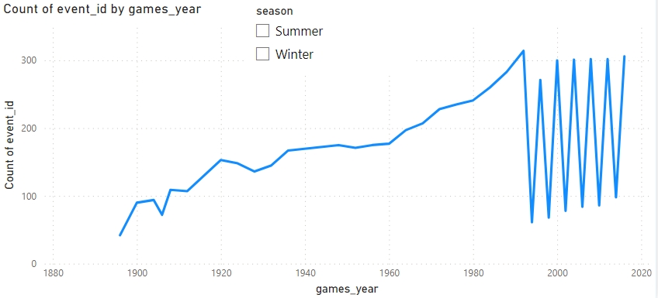
How has the number of events changed over time?
Based on the dataset, the analysis reveals that for the summer Olympics the number of events have been consistently increases till 2000 decade after that there are no major changes.
On the other hand for the winter Olympics the number of events have consistently increased decade on decade.

Slide 18
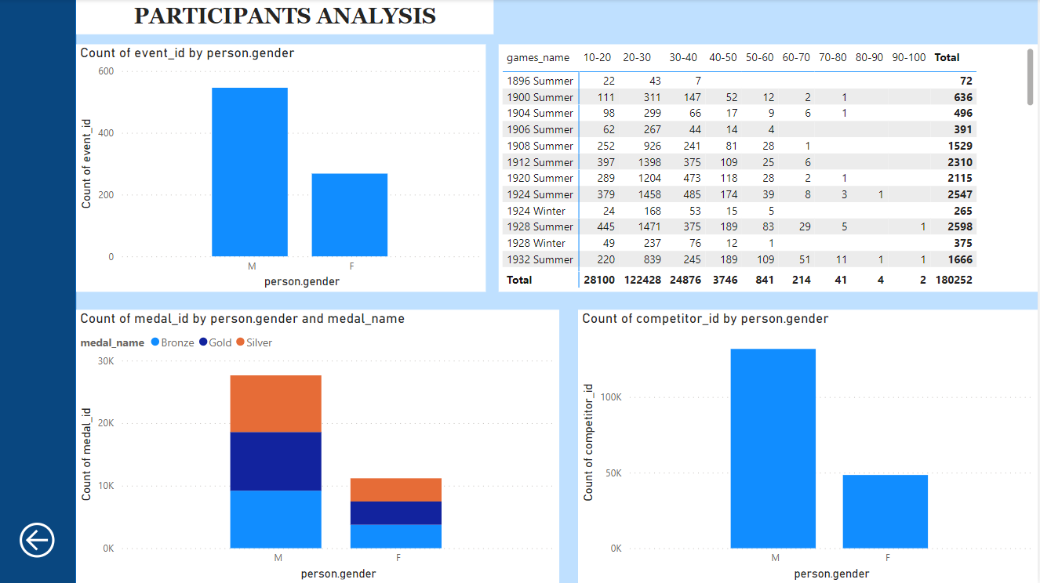

Slide 19
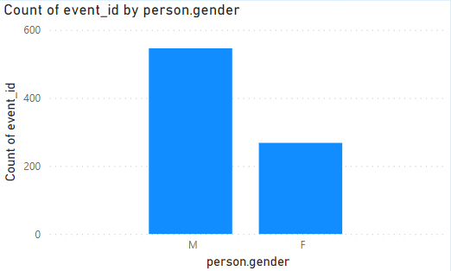
What is the distribution of events by gender (Men, Women, Mixed)?
Based on the dataset, the analysis reveals that in Olympics games there is a huge difference in the number of events held for men and women.

Slide 20
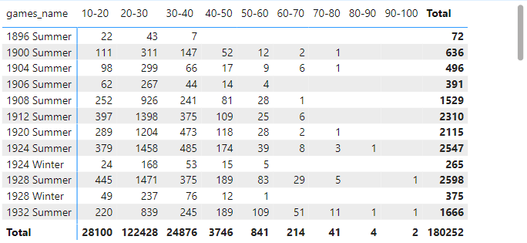
How does the age distribution of participants vary across different games?
Based on the dataset, the analysis reveals that the highest number of participation is coming from age group 10-20, 20-30 & 30-40. Where there is very low participation from age groups like 60-70, 70-80 etc.

Slide 21
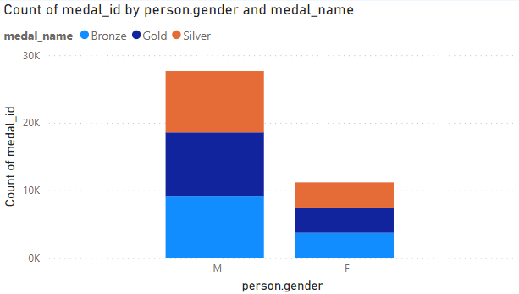
How is the medal distribution across gender ?
Based on the dataset, we have seen in the earlier analysis that there are higher number of events for males across Olympic games, hence males has won more number of medals as compare to female.

Slide 22
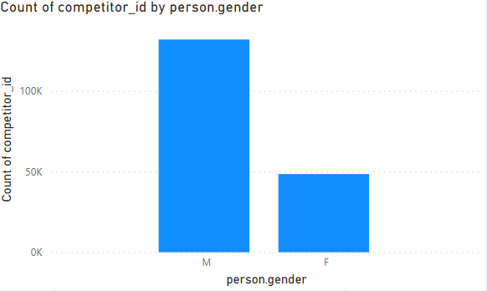
What is the distribution of participants by gender?
Based on the dataset, we have seen in the earlier analysis that there are higher number of events for males across Olympic games, hence there are higher number male participants as compare to female.

Slide 23
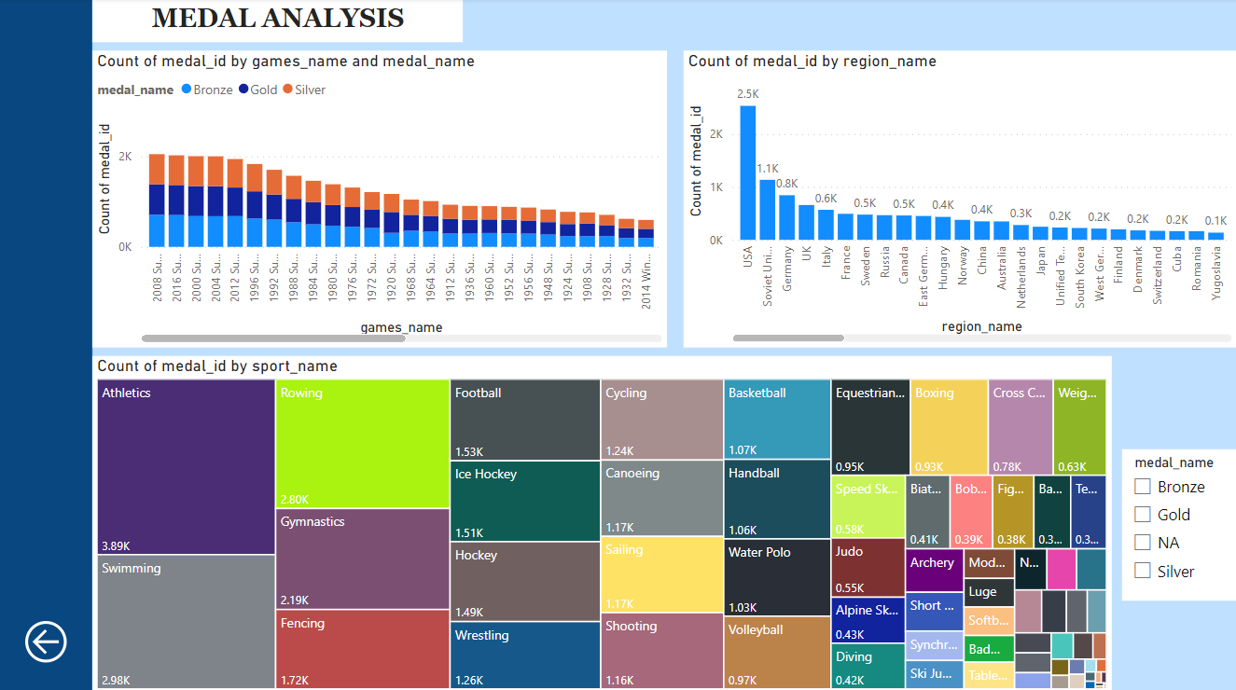

Slide 24
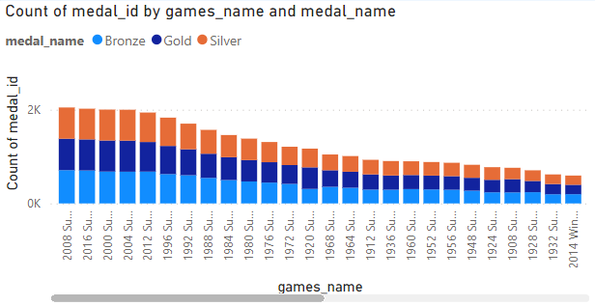
How many medals have been awarded in each Olympics?
Based on the dataset, the analysis reveals that the highest number of medals have distributed in the Olympic games 2008 summer, 2016 summer, 2000 summer. And the least number of medals have been provided for the winter games like 1932, 1928, 1924.

Slide 25
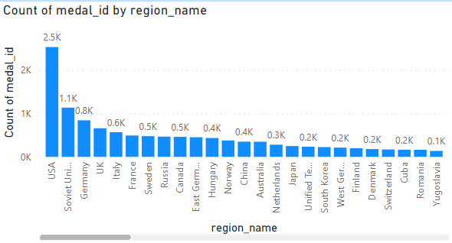
Which countries have the highest number of gold medals?
Based on the dataset, the analysis reveals that the highest number of gold medals have been won by USA. Thereafter countries like Soviet Union, Germany and UK have also won huge number of gold medals.

Slide 26
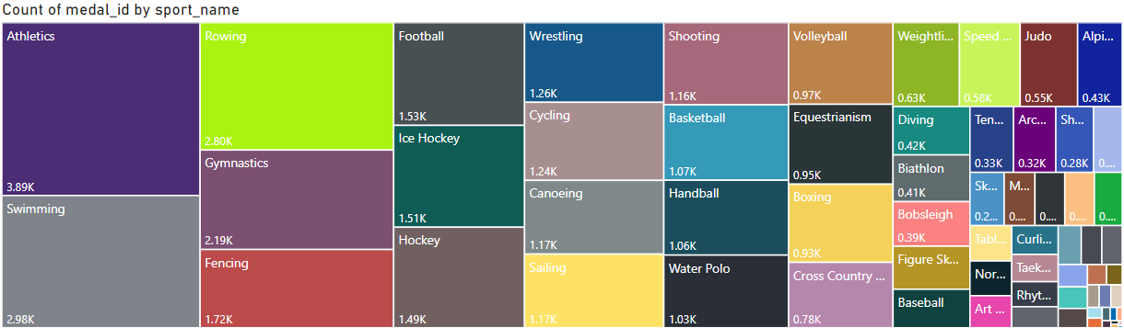
How does the medal distribution vary across different sports?
Based on the dataset, the analysis reveals that sports like Athletics, Gymnastics, Fencing and Rowing have highest number of Medals received.

Slide 27
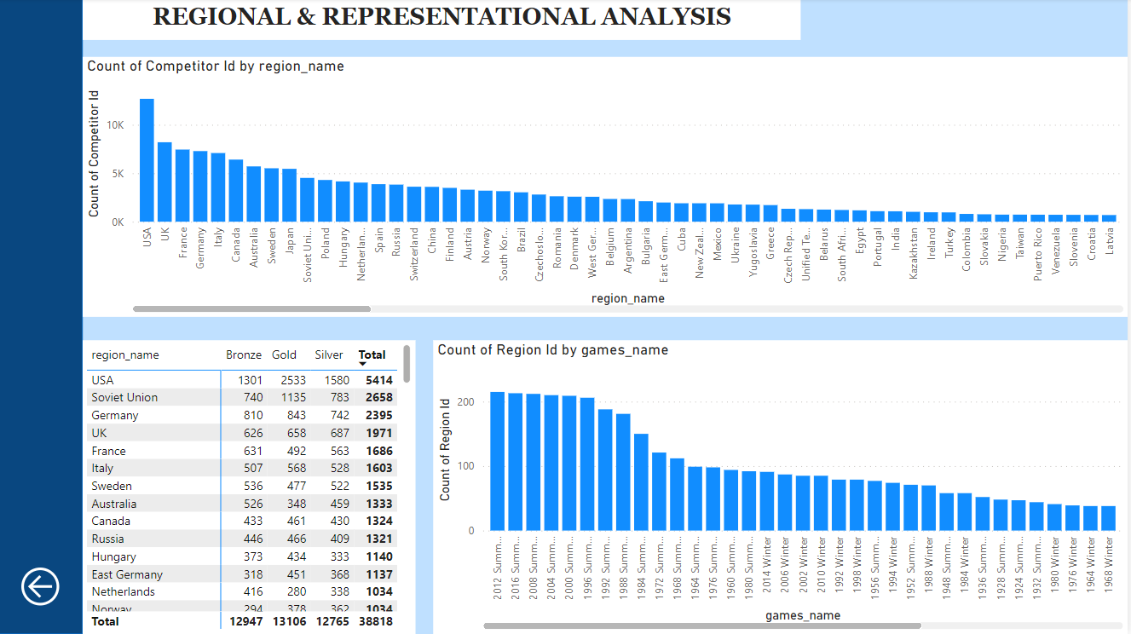

Slide 28
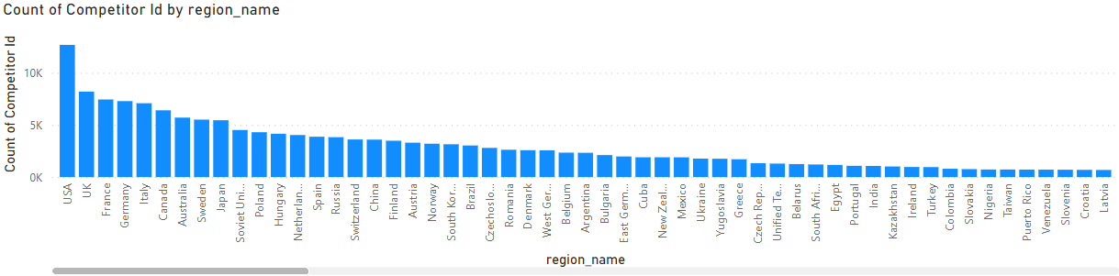
Which regions have the highest number of participants in the Olympics?
Based on the dataset, the analysis reveals that USA have the highest number of participants followed by UK, France and Germany.

Slide 29
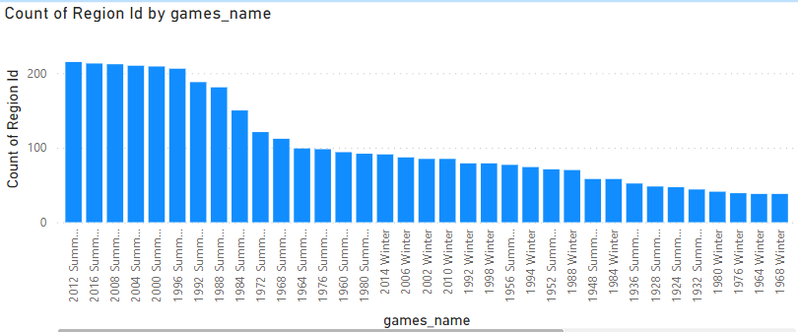
How many regions or NOCs participate in each Olympic Games?
Based on the dataset, the analysis reveals that Olympic game 2012 summer has 215 regions participated, 2016 summer has 213, 2008 summer has 212, 2004 has 210 and so on.

Slide 30
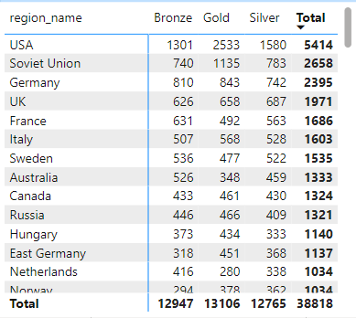
What is the distribution of medals among different regions?
Through the analysis we can see the distribution and the count of silver, gold and bronze medal for each regions.

Slide 31
EDA ANALYSIS

Slide 32
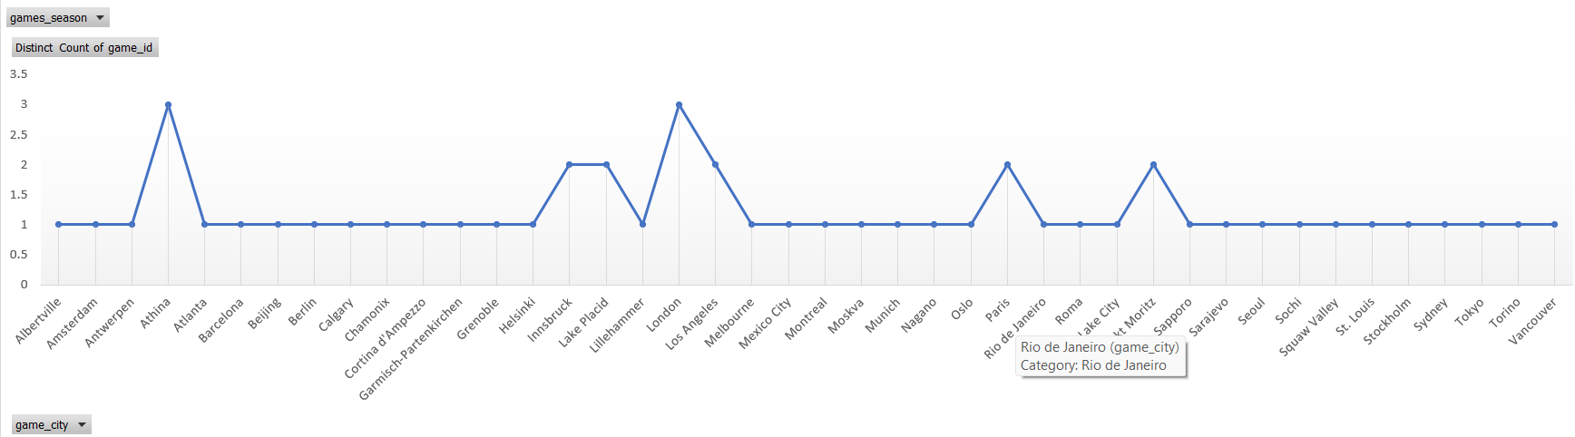
Are there any trends or patterns in the frequency of hosting Olympic Games?
Based on the dataset, the analysis reveals that regions like Athina and London have hosted Olympic games for more than 2 times.
And regions like Innsbruck, Lake placid, Paris and Sankt Moritz have hosted Olympic games for 2 times.

Slide 33
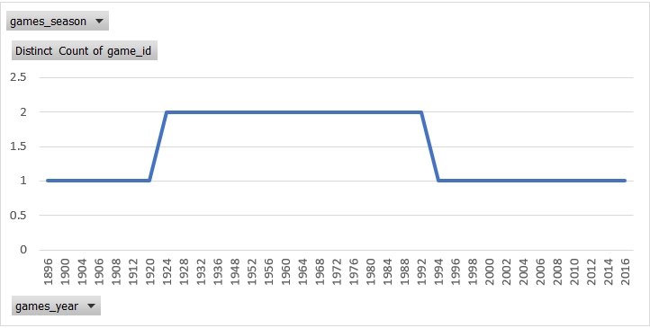
How has the duration of Olympic Games changed over time?
Based on the dataset, the analysis reveals that from year 1896 to 1920 & year 1994 to 2016 there were only one Olympic game organized in an individual year. Wherein, in the year 1924 to 1992 there were two Olympic games organized in an individual year.

Slide 34
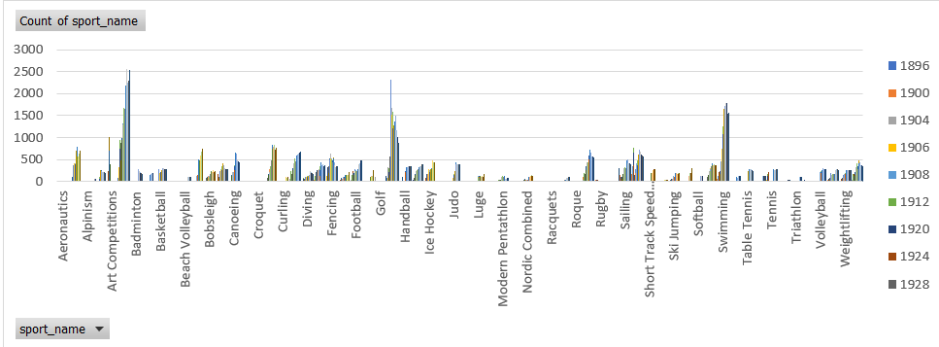
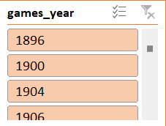

Are there any emerging sports that have been recently added to the Olympics?
Based on the dataset, the analysis reveals that the below mentioned sports are the emerging sports that have been recently added to the Olympics.
Rugby Sevens 2016 Taekwondo 2000 2004 2008 2012 2016 Triathlon 2000 2004 2008 2012 2016 Tug-Of-War 1900 1904 1906 1908 1912 1920

Slide 35
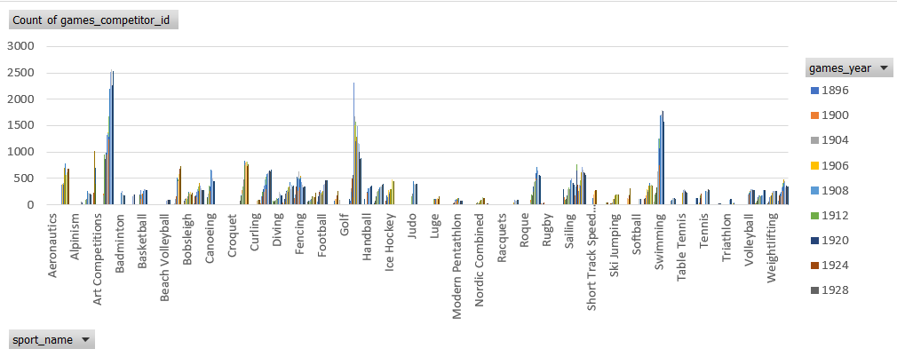
How has the popularity of certain sports changed over the years?
Based on the dataset, the analysis provide that the popularity of certain sports have been increased tremendously. For e.g, Art Competition has 26 and 11 participants in the year 1912 and 1920, then we have Swimming which has 7, 1788 and 1777 in the year 1896, 2000 and 2008, and many other sports available in the dataset. Hence we can clearly see that the popularity for certain sports have increases year on year.

Slide 36
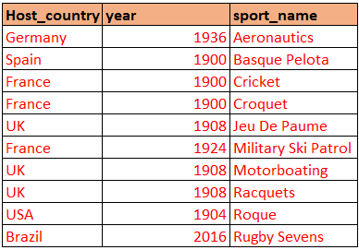
Are there any sports that are specific to a particular region or culture?
Based on the dataset, the analysis reveals that the above mentioned sports are specific to these regions.

Slide 37
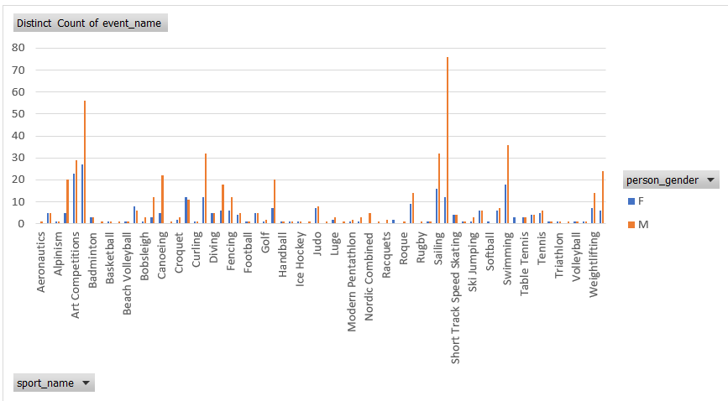
Are there any sports that have a higher number of events for one gender compared to others?
Based on the dataset, the analysis reveals that almost all the sports have higher number of events for males in each Olympic game. Only in few of the sports number of events are equal for both male and female. For e.g, sports like Alpine Skiing, Badminton, Diving and Table tennis etc.

Slide 38
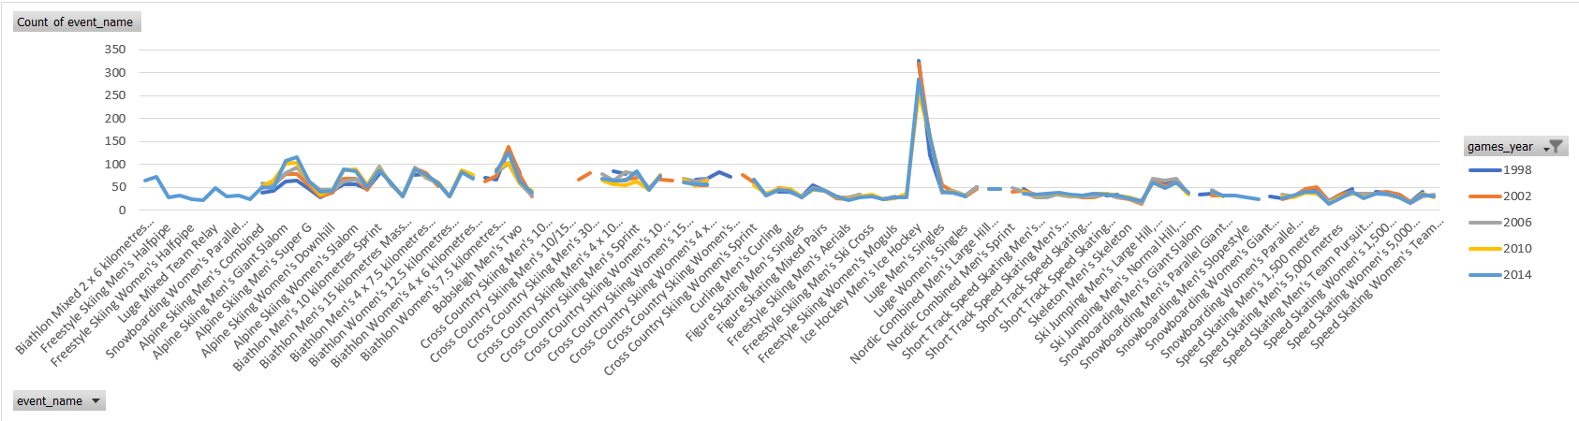
Are there any new events that have been introduced in recent editions of the Olympics? Are there any events that have been discontinued or removed from the Olympics?
Based on the dataset, the analysis reveals that these are the few recent addition and discontinued events from the Olympics games.

Slide 39
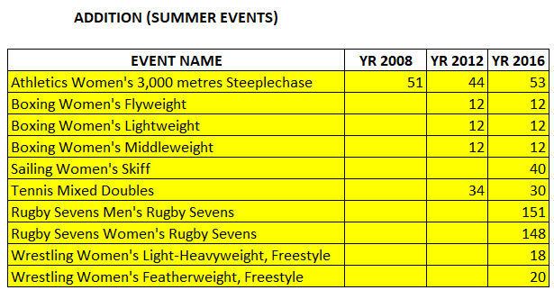
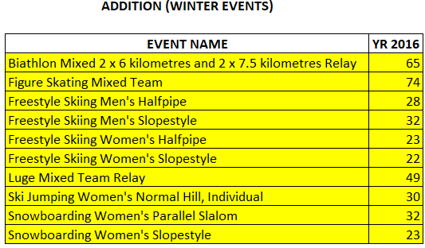
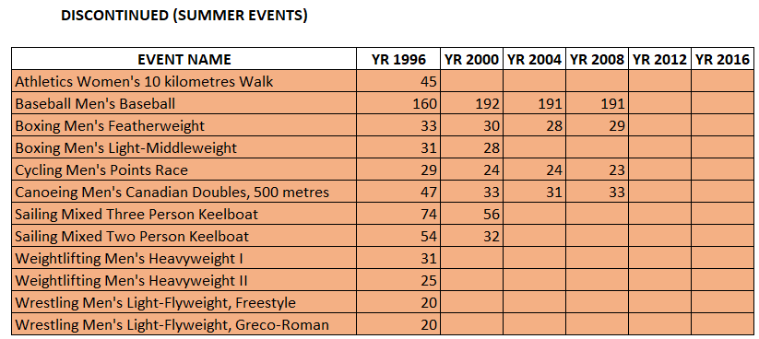
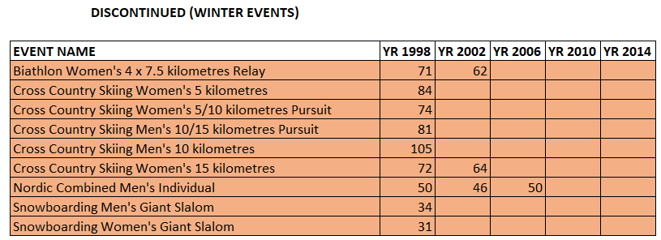

Slide 40
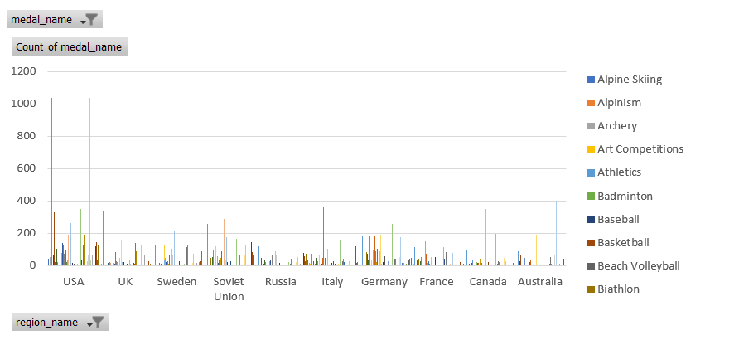
Are there any dominant countries or regions in specific sports or events? Are there any sports or events that have a higher number of medalists from a specific region?
Based on the dataset, this chart shows the number of medals won by every region in different sports. By using the slicer we can see the dominant countries in each sports and vice versa.

Slide 41
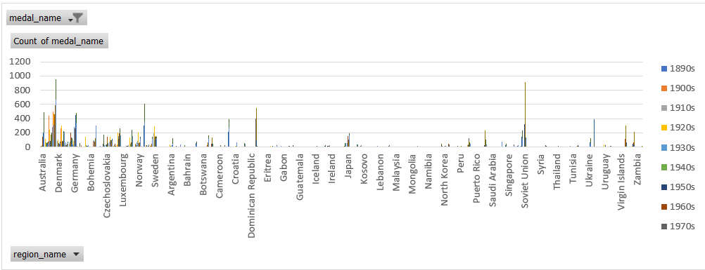
Are there any countries that consistently perform well in multiple Olympic editions?
Based on the dataset, the analysis reveals that USA is the region which has won the highest number of medals in multiple Olympic editions.

Slide 42
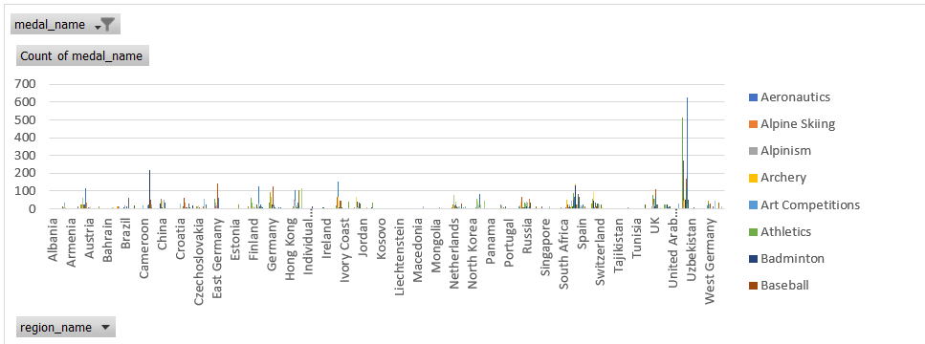
What are some notable instances of unexpected or surprising medal wins?
Based on the dataset, the analysis reveals that there are many unexpected and surprising medals wins year on year. I have analysed the surprising and unexpected wins for INDIA. India has won its first athletics medal in the year 1900 (SILVER- Athletics Men’s 200 metres), badminton meda in the year 2012 (BRONZE- Badminton Women’s single’s) and shooting medal in 2008 (GOLD- Shooting Men’s Air Rifle, 10 mtrs).

Slide 43
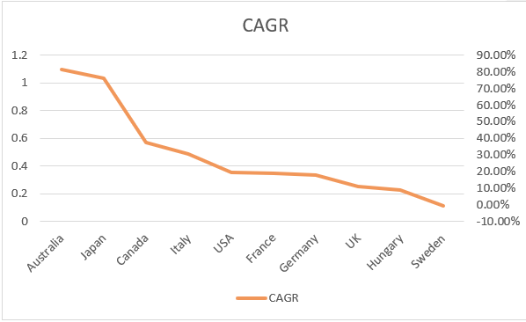
Are there any regions that have experienced significant growth or decline in Olympic participation?
Based on the dataset, the analysis reveals that some of the regions experience a significant growth in their participation number while other have seen the decline. Like Australia have seen a massive growth over the decades, from having 3 participants in 1910s to 1177 in 2010s. On the other hand Sweden have 713 participants in 1910s which is a decent number, but it declined to 294 in 1940s and then 676 in 2010s, which means that for Sweden seen growth and decline both. But if you will see through CAGR then Sweden has seen decline over the decades.

Slide 44
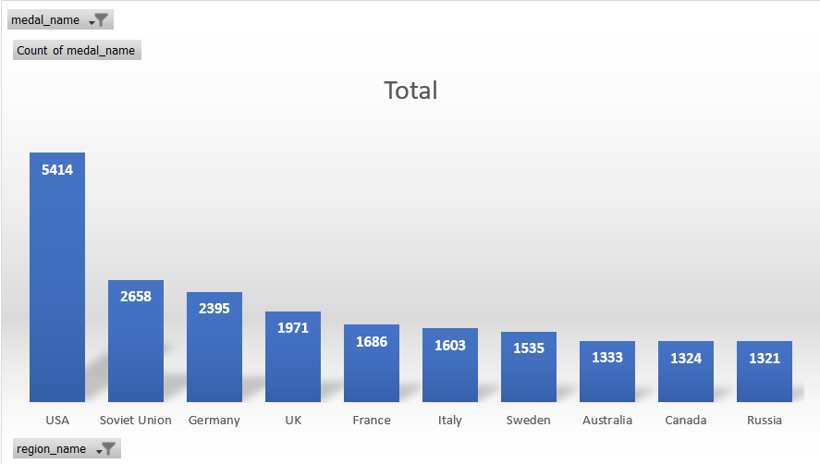
Are there any regions that have had a notable impact on the overall medal tally?
Based on the dataset, the analysis reveals that USA has a notable impact on the overall medal tally as the highest number of medals have been won the USA.

Slide 45
Thank you !
POOJA SINHA
poojasinha18799@gmail.com

